Slide 2
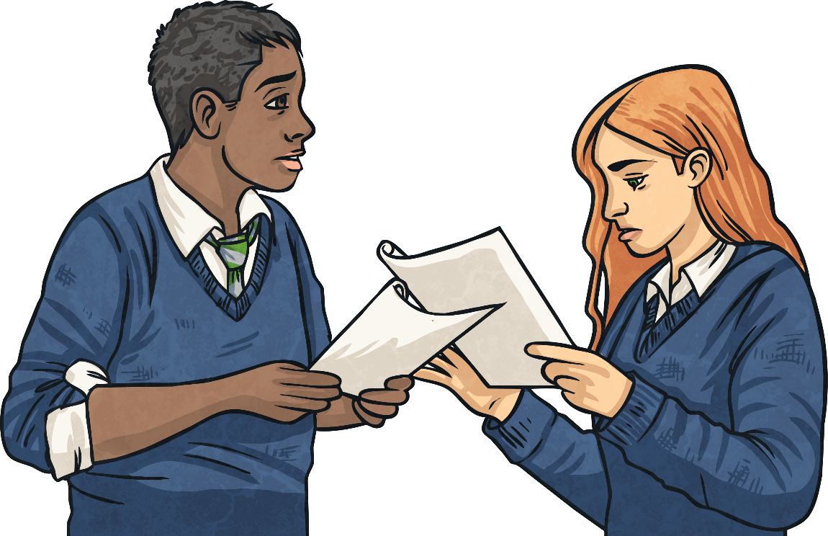
Writing a Diary Entry
When you write a diary entry you are writing about a day in the life of a real person or character. The diary entry needs to sound as if the person or character has written it so it needs to be written from their point of view. It also needs to be exciting and interesting to read. To get this right, just follow a few easy steps...

Slide 3
Diary Writing Must…
include the date and/or time
The date or time can be written at the top of the page like this...
or it can be included in the first few sentences of a diary entry like this...
Over the past months, I have been watching my crew members in the freezing temperatures…
It is important because it tells the reader exactly when the diary is being written.
Over the past months, I have been watching my crew members in the freezing temperatures…
It is important because it tells the reader exactly when the diary is being written.

Slide 4
Diary Writing Must…
be written in the first person.
This means including pronouns such as ‘I’, ‘my’, ‘we’ and ‘our’.
These words are special because they tell us the diary is being written by someone and they are talking about themselves.
Look at these two examples. Which one uses the correct words to be written in the ‘first person’?
This means including pronouns such as ‘I’, ‘my’, ‘we’ and ‘our’.
These words are special because they tell us the diary is being written by someone and they are talking about themselves.
Look at these two examples. Which one uses the correct words to be written in the ‘first person’?

Slide 5
Diary Writing Must…
be written in the first person.
As I looked down from our lofty home, I noticed a group of humans. They seemed to be holding loud, bright monsters with sharp, glistening teeth that were tearing our trees from the ground.
As she looked down from their lofty home, she noticed a group of humans. They seemed to be holding loud, bright monsters with sharp, glistening teeth that were tearing their trees from the ground.
As I looked down from our lofty home, I noticed a group of humans. They seemed to be holding loud, bright monsters with sharp, glistening teeth that were tearing our trees from the ground.
As she looked down from their lofty home, she noticed a group of humans. They seemed to be holding loud, bright monsters with sharp, glistening teeth that were tearing their trees from the ground.
First person
Not first person

Slide 6
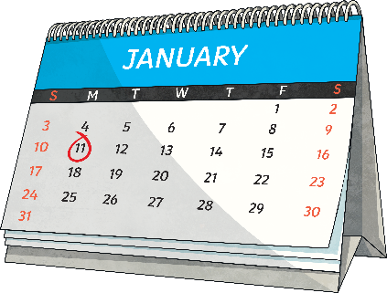
Diary Writing Must…
use past tense for the main events.
Diaries are usually written about an event that has already occurred so should be written in the past tense.
Which of these examples is written in the past tense?
Two days ago, something dreadful happened – ‘Endurance’ became stuck in a large sheet of floating ice (an ice floe) following risky conditions crossing the Weddell Sea.
Today, something dreadful will happen – ‘Endurance’ will stick in a large sheet of floating ice (an ice floe) following risky conditions crossing the Weddell Sea.
Diaries are usually written about an event that has already occurred so should be written in the past tense.
Which of these examples is written in the past tense?
Two days ago, something dreadful happened – ‘Endurance’ became stuck in a large sheet of floating ice (an ice floe) following risky conditions crossing the Weddell Sea.
Today, something dreadful will happen – ‘Endurance’ will stick in a large sheet of floating ice (an ice floe) following risky conditions crossing the Weddell Sea.
Past tense
Future tense

Slide 7
Diary Writing Must…
include an introduction to set the scene.
It is important to set the scene when writing a diary to ensure that it is clear what you are writing about.
You might answer the questions who, what, where or when.
Which of the following extracts is an introduction? How do you know?
Today has been an unusually busy day for me! When I woke up this morning, I noticed that the usual calm atmosphere within our group had been replaced by one of panic.
Today has been an unusually busy day for me! When I woke up this morning, I noticed that the usual calm atmosphere within our group had been replaced by one of panic.
For now I must catch up on eating and sleeping and hope that they do not return tomorrow.

Slide 8
Diary Writing Must…
tell events in chronological order.
In a diary we usually write about the events of our day in the order they happened.
We only include the most important or interesting events.
Which of these would you include in a diary?
I ate breakfast.
X
We visited the most amazing museum.
✓
An exhibit came to life!
✓
We had to evacuate the museum.
✓
I had a nap.
✓
You might choose to include information about breakfast and having a nap if it is relevant or unusual.

Slide 9
Diary Writing Must…
include personal emotions and feelings.
A diary is usually a secret place to write the truth about how you feel about what has happened to you in the day.
In a diary you might include feelings, hopes or fears that you wouldn’t want anyone to know about.
Look at the examples below. Where have these diary writers described their feelings?
Egypt is such a rich, powerful country and although I am nervous about ruling it, I would rather do so alone.
Yesterday, feeling relieved, we reached the island of South Georgia and then completed a day long trek to find a whaling station…
Egypt is such a rich, powerful country and although I am nervous about ruling it, I would rather do so alone.
Yesterday, feeling relieved, we reached the island of South Georgia and then completed a day long trek to find a whaling station…

Slide 10
Diary Writing Must…
use time conjunctions and adverbials, e.g. ‘after that, ‘before lunch’, ‘until sunset’.
A diary is usually describing lots of events. To make sense of when these events happened, it is helpful to include time conjunctions and adverbials.
If we just use one word such as ‘then’ to link the events in our diary it can get very boring!
Look at the example below. Can you identify the time conjunctions and adverbials that have been used?
Later, we will organise a lavish funeral for father that will last for days, with plenty of music as he would have wanted.
After hearing the news of my father’s death, I overheard the members of the court discussing what is to happen.
Later, we will organise a lavish funeral for father that will last for days, with plenty of music as he would have wanted.
After hearing the news of my father’s death, I overheard the members of the court discussing what is to happen.

Slide 11
Find the features
Dear Diary, Mon 31st October
Yesterday started as usual but changed very suddenly. As soon as I entered the kitchen, I knew something was wrong.
My witch was nowhere to be seen. My food was not in the bowl and the door was wide open. I began to feel anxious as I noticed the broom and wand were missing…
Which features can you see in the following example?
Dear Diary, Mon 31st October
Yesterday started as usual but changed very suddenly. As soon as I entered the kitchen, I knew something was wrong.
My witch was nowhere to be seen. My food was not in the bowl and the door was wide open. I began to feel anxious as I noticed the broom and wand were missing…
introduction
date
time conjunctions and adverbials
feelings
first person
past tense

Slide 12
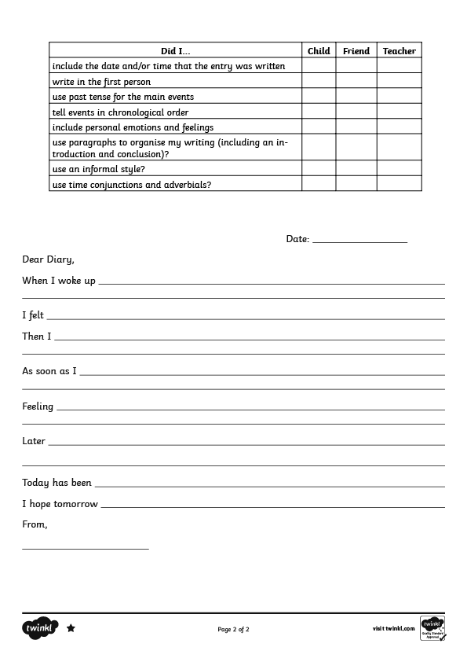
Find the features
Use the Differentiated Diary Examples to find the features of diaries using the Diary Writing Checklist to help you.

Slide 13
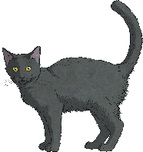
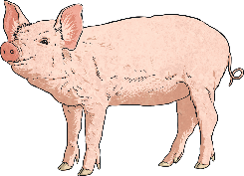
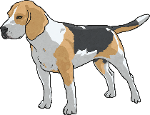
Write a diary
Now it’s your turn!
Using the Differentiated Diary Writing Activity Sheets, plan and write a diary from the point of view of an animal. Don’t forget to include everything on the Diary Writing Checklist.
Will you be…
a witch’s cat?
a safari lion?
your own pet?
a farmyard animal?
a rainforest creature?
a polar animal?

Slide 14
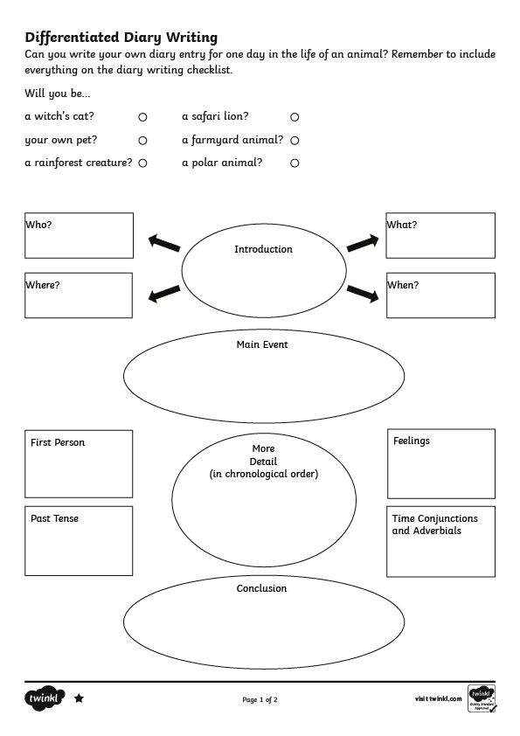
Write a diary

Slide 15
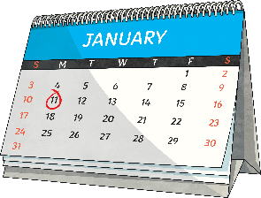
Diary Writing Check List
Can you remember all the things you need to do to write a fantastic diary entry?
Diary writing must...
include the date and/or time.
✓
write in the first person.
✓
use past tense for main events.
✓
include an introduction to set the scene.
✓
tell events in chronological order.
✓
include personal emotions and feelings.
✓
use time conjunctions and adverbials, e.g. ‘after that’, ‘before lunch’, ‘until sunset’.
✓

